Slide 1

ATLIQ HARDWARES
Consumer Goods Ad-Hoc Insights
-Nutan Shinde

Slide 2



Introduction to AtliQ Hardwares
Atliq Hardware is a leading computer hardware producer based in India, renowned for its high-quality components and innovative solutions. With a strong presence in the domestic and international markets, the company focuses on customer satisfaction, technological advancement, and data-driven decision-making to drive business growth.
Domain - Consumer Goods

Slide 3


Problem Statement
Atliq Hardwares, a prominent computer hardware producer in India with an extensive international presence, has identified a need for improved data-informed decision-making. The management has observed a lack of sufficient insights to make quick and intelligent decisions. To address this, the company aims to enhance its data analytics capabilities by recruiting junior data analysts to the team. These analysts should possess a combination of technical expertise and strong soft skills to effectively analyze data and provide valuable insights for informed decision-making.

Slide 4
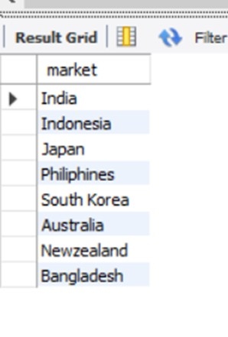
AD_HOC REQUEST
INPUT
OUTPUT
1. Provide the list of markets in which customer "Atliq
Exclusive" operates its business in the APAC region

Slide 5

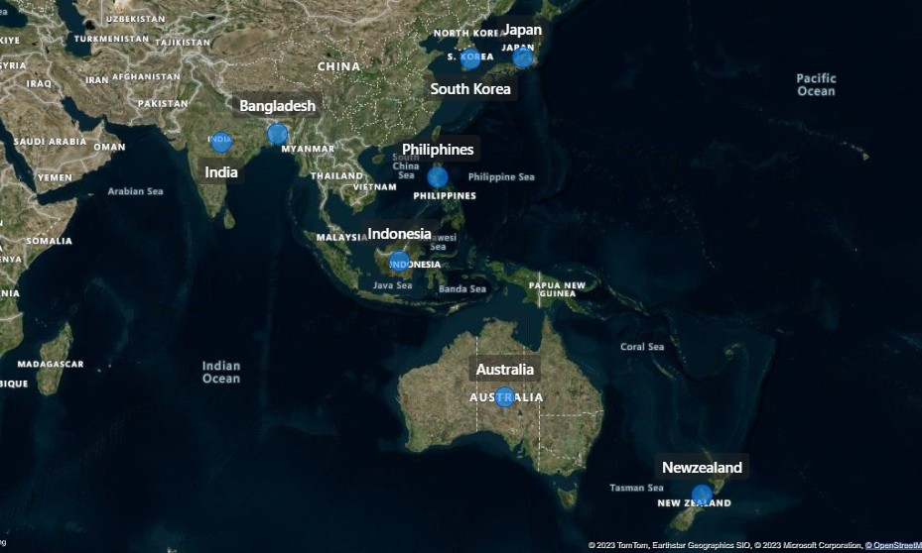

INSIGHTS
Atliq Exclusive focuses its business operations in the APAC region across a select number of markets. Specifically, the company operates in eight key markets, namely India, Indonesia, Japan, Philippines, South Korea, Australia, New Zealand, and Bangladesh.

Slide 6
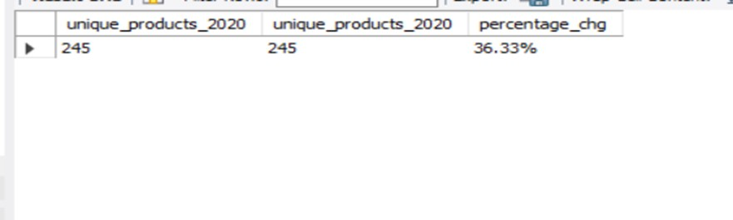
AD_HOC REQUEST
INPUT
OUTPUT
2 . What is the percentage of unique product increase in 2021 vs. 2020? The final output contains these fields, unique_products_2020 unique_products_2021 percentage_chg

Slide 7
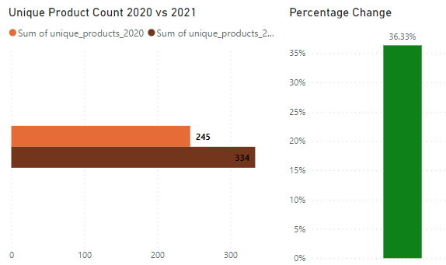
INSIGHTS
Atliq Hardware experienced a significant increase in its product offerings over the course of one year. In 2020, the company had 245 unique products, while in 2021, the number rose to 334 unique products. This indicates a notable growth of 36.33% in Atliq Hardware's product portfolio.

Slide 8
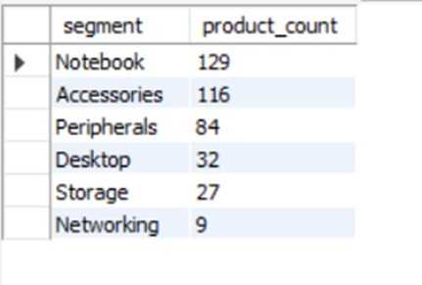
AD_HOC REQUEST
INPUT
OUTPUT
3.Provide a report with all the unique product counts for each segment and sort them in descending order of product counts. The final output contains 2 fields, segment product_count

Slide 9
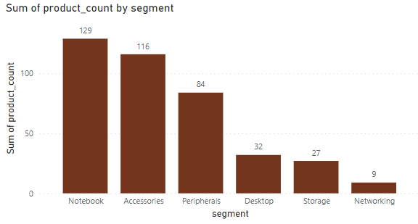
INSIGHTS
Based On Output It Has 6 Segments That Contains Notebook , Accessories , Peripherals , Desktop , Storage And Networking.
The Notebook Segment Contain The Highest Number Of Count Of Product Is 129 And Network Segment Contains The Lowest Count Of Product Is 9.

Slide 10
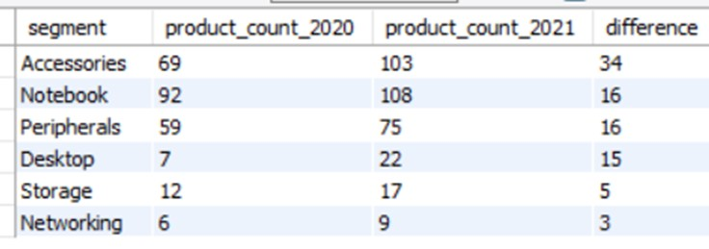
AD_HOC REQUEST
INPUT
OUTPUT
4. Follow-up: Which segment had the most increase in unique products in 2021 vs 2020? The final output contains these
fields,
segment product_count_2020 product_count_2021 difference

Slide 11
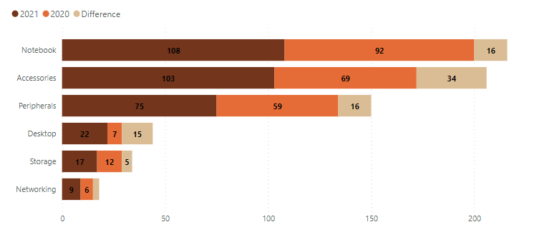
INSIGHTS
The visual representation illustrates that all segments in 2021 have experienced growth compared to the previous year, 2020. Specifically, the Accessories segment saw an increase of 34 new products from 2020 to 2021.
Both the Notebook and Peripheral segments witnessed a growth of 16 additional products during the same period.

Slide 12
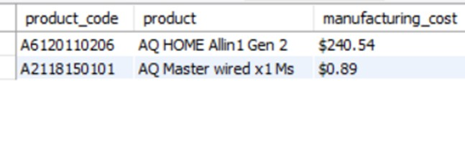
AD_HOC REQUEST
INPUT
OUTPUT
5. Get the products that have the highest and lowest manufacturing costs. The
final output should contain these fields, product_code product manufacturing_cost

Slide 13
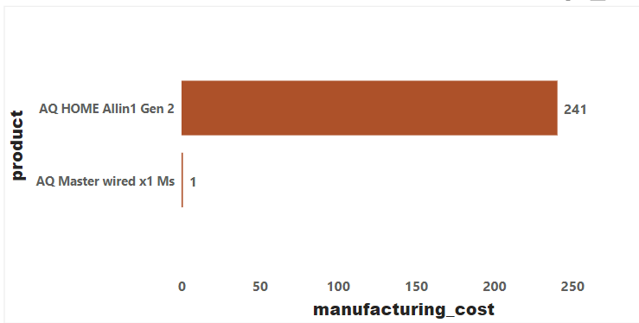
INSIGHTS
AQ HOME Allin1 Gen 2 Is The Highest Manufacturing Cost Of 240.54.
•
AQ Master Wired X1 Ms Is The Lowest Manufacturing Cost Of 0.892.

Slide 14
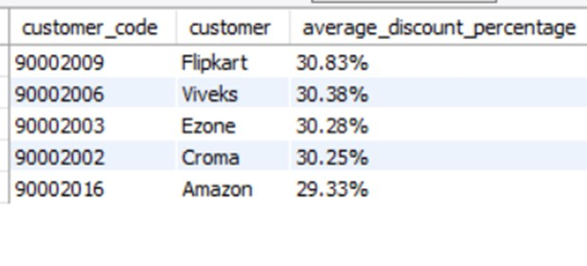
AD_HOC REQUEST
INPUT
OUTPUT
6. Generate a report which contains the top 5 customers who received an
average high pre_invoice_discount_pct for the fiscal year 2021 and in the Indian market. The final output contains these fields, customer_code customer average_discount_percentage

Slide 15
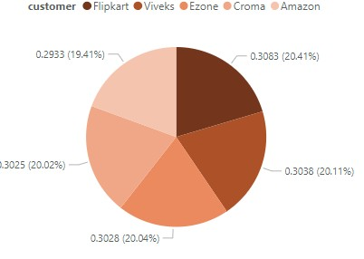
INSIGHTS
During the fiscal year 2021 in India, Flipkart emerged as the customer with the highest average pre-invoice discount percentage, standing at 20.65%. Flipkart, along with Viveks, Ezone, Croma, and Vijay Sales, comprised the top five customers based on their contribution in terms of average high pre-invoice discount percentage in India.

Slide 16
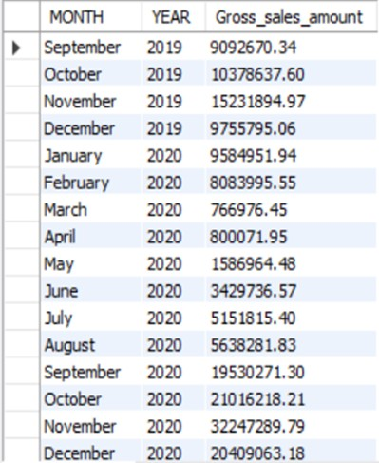
AD_HOC REQUEST
INPUT
OUTPUT
7. Get the complete report of the Gross sales amount for the customer “Atliq
Exclusive” for each month. This analysis helps to get an idea of low and high- performing months and take strategic decisions. The final report contains these columns: Month Year
Gross sales Amount

Slide 17
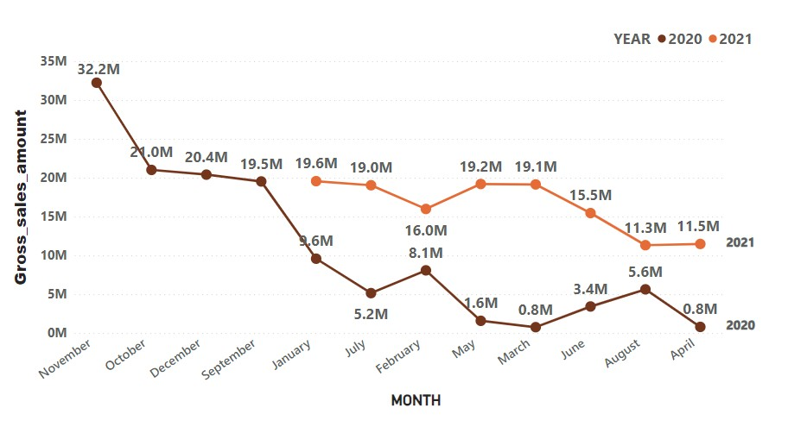
INSIGHTS
Atliq Exclusive, a customer, recorded varying gross sales amounts throughout the months. The highest gross sales occurred in November 2020, reaching a peak of 32 million. Conversely, the lowest gross sales figure of 0.77 million was observed in March 2020.

Slide 18
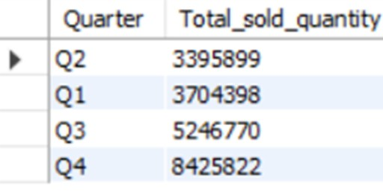
AD_HOC REQUEST
INPUT
OUTPUT
8.In which quarter of 2020, got the maximum total_sold_quantity? The final output contains these fields sorted by the total_sold_quantity,
Quarter total_sold_quantity

Slide 19
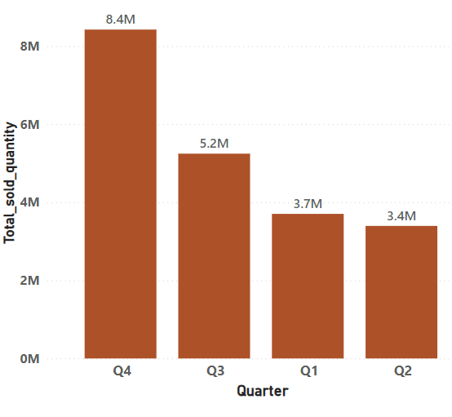
INSIGHTS
•The Maximum Of Total_sold_quantity Of Gross Sales Is Quarter Q4
8.4 Millions
•The Minimum Of Total_sold_quantity Of Gross Sales Is Quarter Q2
3.4 Millions

Slide 20
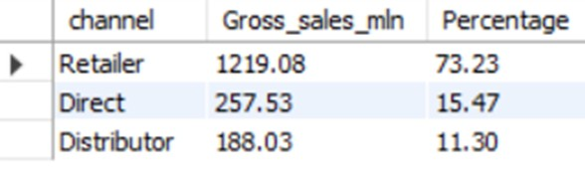
AD_HOC REQUEST
INPUT
OUTPUT
9. Which channel helped to bring more gross sales in the fiscal year 2021 and the
percentage of contribution? The final output contains these fields,
channel gross_sales_mln percentage

Slide 21
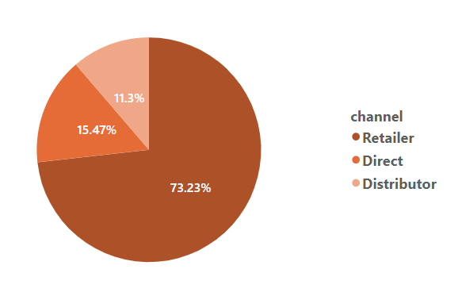
INSIGHTS
In the fiscal year 2021, the Retailer channel emerged as the primary driver of gross sales, contributing a significant percentage of 73.23% to the company's revenue.
On the other hand, the Distributor channel had a comparatively lower contribution of 11.3% to the company's gross sales in the same fiscal year.
The Retailer channel's strong performance highlights its effectiveness in reaching customers and driving sales, underscoring its importance in Atliq Exclusive's business strategy.

Slide 22
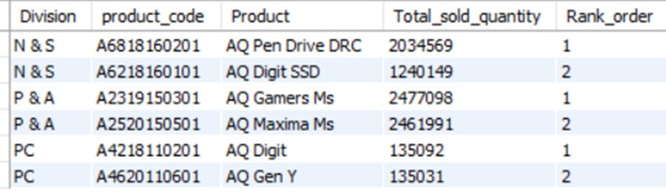
AD_HOC REQUEST
INPUT
OUTPUT
10. Get the Top 3 products in each division that have a high
total_sold_quantity in the fiscal_year 2021? The final output contains these fields,
division product_code product total_sold_quantity rank_order

Slide 23
THANK YOU!

